Slide 1
Java Concurrency & Multithreading programming

Slide 2
Contents
1. Java Concurrency
2. Multithreading programming

Slide 3
1. Java Concurrency

Slide 4
Definitions
Parallel processes—two or more Threads are running simultaneously, on different cores (processors), in the same computer
Concurrent processes—two or more Threads are running asynchronously, on different cores (processors), in the same computer
Asynchronous means that you cannot tell whether operation A in Thread #1 happens before, during, or after operation B in Thread #2
Asynchronous processes may be running simultaneously, on different cores, or they may be sharing time on the same core

Slide 5
Problems
Concurrency introduces the following hazards:
Race conditions—if two or more processes try to write to the same data space, or one tries to write and one tries to read, it is indeterminate which happens first
Deadlock—two or more processes are each waiting for data from the other, or are waiting for the other to finish
Livelock—two or more processes each repeatedly change state in an attempt to avoid deadlock, but in so doing continue to block one another
Starvation—a process never gets an opportunity to run, possibly because other processes have higher priority

Slide 6
Threads
There are two ways to create a Thread:
Define a class that extends Thread
Supply a public void run() method
Create an object o of that class
Tell the object to start: o.start();
Define a class that implements Runnable (hence it is free to extend some other class)
Supply a public void run() method
Create an object o of that class
Create a Thread that “knows” o: Thread t = new Thread(o);
Tell the Thread to start: t.start();

Slide 7
Mutable and immutable objects
If an object is immutable (cannot be changed), then any number of Threads may read this object (or different portions of this object) at any time
Sun provides a number of immutable objects
You can create an ad hoc immutable object by simply not providing any way to change it
All fields must be final (private may not be enough)
No methods may change any of the object’s data
You must ensure no access to the object until after it is completely constructed
If an object is mutable (can be changed), and accessible by more than one Thread, then every access (write or read) to it must be synchronized
Don’t try to find clever reasons to think you can avoid synchronization

Slide 8
The synchronized statement
Synchronization is a way of providing exclusive access to data
You can synchronize on any Object, of any type
If two Threads try to execute code that is synchronized on the same object, only one of them can execute at a time; the other has to wait
synchronized (someObject) { /* some code */ }
This works whether the two Threads try to execute the same block of code, or different blocks of code that synchronize on the same object
Often, the object you synchronize on bears some relationship to the data you wish to manipulate, but this is not at all necessary

Slide 9
synchronized methods
Instance methods can be synchronized:
synchronized public void myMethod( /* arguments */) { /* some statements */ }
This is equivalent to
public void myMethod( /* arguments */) { synchronized(this) { /* some statements */ } }
Static methods can also be synchronized
They are synchronized on the class object (a built-in object that represents the class)

Slide 10
Locks
When a Thread enters a synchronized code block, it gets a lock on the monitor (the Object that is used for synchronization)
The Thread can then enter other code blocks that are synchronized on the same Object
That is, if the Thread already holds the lock on a particular Object, it can use any code also synchronized on that Object
A Thread may hold a lock on many different Objects
One way deadlock can occur is when
Thread A holds a lock that Thread B wants, and
Thread B holds a lock that Thread A wants

Slide 11
Atomic actions
An operation, or block of code, is atomic if it happens “all at once,” that is, no other Thread can access the same data while the operation is being performed
x++; looks atomic, but at the machine level, it’s actually three separate operations:
load x into a register
add 1 to the register
store the register back in x
Suppose you are maintaining a stack as an array: void push(Object item) { this.top = this.top + 1; this.array[this.top] = item; }
You need to synchronize this method, and every other access to the stack, to make the push operation atomic
Atomic actions that maintain data invariants are thread-safe; compound (non-atomic) actions are not
This is another good reason for encapsulating your objects

Slide 12
Check-then-act
A Vector is like an ArrayList, but is synchronized
Hence, the following code looks reasonable:
if (!myVector.contains(someObject)) { // check myVector.add(someObject); // act }
But there is a “gap” between checking the Vector and adding to it
During this gap, some other Thread may have added the object to the array
Check-then-act code, as in this example, is unsafe
You must ensure that no other Thread executes during the gap
synchronized(myVector) { if (!myVector.contains(someObject)) { myVector.add(someObject); } }
So, what good is it that Vector is synchronized?
It means that each call to a Vector operation is atomic

Slide 13
Synchronization is on an object
Synchronization can be done on any object
Synchronization is on objects, not on variables
Suppose you have synchronized(myVector) { … }
Then it is okay to modify myVector—that is, change the values of its fields
It is not okay to say myVector = new Vector();
Synchronization is expensive
Synchronization entails a certain amount of overhead
Synchronization limits parallelism (obviously, since it keeps other Threads from executing)
Moral: Don’t synchronize everything!

Slide 14
Local variables
A variable that is strictly local to a method is thread-safe
This is because every entry to a method gets a new copy of that variable
If a variable is of a primitive type (int, double, boolean, etc.) it is thread-safe
If a variable holds an immutable object (such as a String) it is thread-safe, because all immutable objects are thread-safe
If a variable holds a mutable object, and there is no way to access that variable from outside the method, then it can be made thread-safe
An Object passed in as a parameter is not thread-safe (unless immutable)
An Object returned as a value is not thread-safe (unless immutable)
An Object that has references to data outside the method is not thread-safe

Slide 15
Thread deaths
A Thread “dies” (finishes) when its run method finishes
There are two kinds of Threads: daemon Threads and non-daemon Threads
When all non-daemon Threads die, the daemon Threads are automatically terminated
If the main Thread quits, the program will appear to quit, but other non-daemon Threads may continue to run
These Threads will persist until you reboot your computer
The join(someOtherThread) allows “this” Thread to wait for some other thread to finish

Slide 16
Communication between Threads
Threads can communicate via shared, mutable data
Since the data is mutable, all accesses to it must be synchronized
Example:
synchronized(someObj) { flag = !flag; }
synchronized(someObj) { if (flag) doSomething(); }
The first version of Java provided methods to allow one thread to control another thread: suspend, resume, stop, destroy
These methods were not safe and were deprecated almost immediately—never use them!
They are still there because Java never throws anything away
If you want one Thread to control another Thread, do so via shared data

Slide 17
Advice
Any data that can be made immutable, should be made immutable
This applies especially to input data--make sure it’s completely read in before you work with it, then don’t allow changes
All mutable data should be carefully encapsulated (confined to the class in which it occurs)
All access to mutable data (writing and reading it) must be synchronized
All operations that modify the state of data, such that validity conditions may be temporarily violated during the operation, must be made atomic (so that the data is valid both before and after the operation)
Be careful not to leave Threads running after the program finishes

Slide 18
Debugging
“Debugging can show the presence of errors, but never their absence.” -- Edgser Dijkstra
Concurrent programs are nondeterministic: Given exactly the same data and the same starting conditions, they may or may not do the same thing
It is virtually impossible to completely test concurrent programs; therefore:
Test the non-concurrent parts as thoroughly as you can
Be extremely careful with concurrency; you have to depend much more on programming discipline, much less on testing
Document your concurrency policy carefully, in order to make the program more maintainable in the future

Slide 20
Concurrent Programming in Java
Lecture Aims
To give an overview of the Java concurrency model and its relationship to other models
To provide details of Java Threads

Slide 21
Concurrency Models I
Processes versus Threads
Threads
Fibres
Process
thread library
Operating System

Slide 22
Concurrency Models II
Java supports threads
Threads execute within a single JVM
Native threads map a single Java thread to an OS thread
Green threads adopt the thread library approach (threads are invisible to the OS)
On a multiprocessor system, native threads are required to get true parallelism (but this is still implementation dependent)

Slide 23
Concurrency Models III
There are various ways in which concurrency can be introduced by
an API for explicit thread creation or thread forking
a high-level language construct such as PAR (occam), tasks (Ada), or processes (Modula)
Integration with OOP, various models:
asynchronous method calls
early return from methods
futures
active objects
Java adopts the active object approach

Slide 24
Concurrency Models IV
Communication and Synchronization
approaches broadly classified as shared-variable or message passing
many different models, a popular one is a monitor
a monitor can be considered as an object where each of its operation executes in mutual exclusion
lock
procedural interface
encapsulated state

Slide 25
Concurrency Models V
Condition Synchronization
expresses a constraint on the ordering of execution of operations
e.g., data cannot be removed from a buffer until data has been placed in the buffer
Monitors provide condition variables with two operations which can be called when the lock is held
wait: an unconditional suspension of the calling thread (the thread is placed on a queue associated with the condition variable)
notify: one thread is taken from the queue and re-scheduled for execution (it must reclaim the lock first)
notifyAll: all suspended threads are re-scheduled
notify and notifyAll have no effect if no threads are suspended on the condition variable

Slide 26
Concurrency in Java
Java has a predefined class java.lang.Thread which provides the mechanism by which threads are created
However to avoid all threads having to be child classes of Thread, it also uses a standard interface
public interface Runnable {
public void run();
}
Hence, any class which wishes to express concurrent execution must implement this interface and provide the run method
Threads do not begin their execution until the start method in the Thread class is called

Slide 27
Threads in Java
Thread
RunnableObject
parameter to
void run()
Thread()
Thread(Runnable target)
{
void run()
...
void start()
}
...
implements
MyThread
Runnable
void run()
{
void run()
...
}
subclass
association

Slide 28
Communication in Java
Via reading and writing to data encapsulated in shared objects protected by simple monitors
Every object is implicitly derived from the Object class which defines a mutual exclusion lock
Methods in a class can be labeled as synchronized, this means that they can only be executed if the lock can be acquired (this happens automatically)
The lock can also be acquired via a synchronized statement which names the object
A thread can wait and notify on a single anonymous condition variable

Slide 29
The Thread Class
public class Thread extends Object
implements Runnable {
public Thread();
public Thread(String name);
public Thread(Runnable target);
public Thread(Runnable target,
String name);
public Thread(Runnable target,
String name, long stackSize);
public void run();
public void start();
...
}

Slide 30
Thread Creation
Either:
Extend Thread class and override the run method, or
Create an object which implements the Runnable interface and pass it to a Thread object via the Thread constructor
How is the run method of Thread implemented?

Slide 31
Thread Creation: Robot Example
Thread
is driven by
Motor
Controller
controlled by
User
Interface
Robot
1
3

Slide 32
Classes for Robot
public class UserInterface {
// Allows the next position of the robot
// to be obtained from the operator.
public int newSetting (int dim) { ... }
...
}
public class Robot {
// The interface to the Robot itself.
public void move(int dim, int pos) { ... }
// Other methods, not significant here.
}
Note in Java 1.5, dimension would be an enumeration type

Slide 33
Motor Controller extends Thread I
public class MotorController
extends Thread {
public MotorController(int dimension,
UserInterface UI, Robot robo) {
// constructor
super();
dim = dimension;
myInterface = UI;
myRobot = robo;
}

Slide 34
Motor Controller extends Thread II
public void run() {
int position = 0; // initial position
int setting;
while(true) {
// move to position
myRobot.move(dim, position);
// get new offset and update position
setting = myInterface.newSetting(dim);
position = position + setting;
}
}
private int dim;
private UserInterface myInterface;
private Robot myRobot;
}
run
method
overridden

Slide 35
Motor Controller extends Thread III
final int xPlane = 0;
final int yPlane = 1;
final int zPlane = 2;
UserInterface UI = new UserInterface();
Robot robo= new Robot();
MotorController MC1 = new MotorController(
xPlane, UI, robo);
MotorController MC2 = new MotorController(
yPlane, UI, robo);
MotorController MC3 = new MotorController(
zPlane, UI, robo);
threads created

Slide 36
Motor Controller extends Thread IV
MC1.start();
MC2.start();
MC3.start();
When a thread is started, its run method is called and the thread is now executable
When the run method exits, the thread is no longer executable and it can be considered terminated (Java calls this the dead state)
The thread remains in this state until it is garbage collected
In this example, the threads do not terminate

Slide 37
Warning
The run method should not be called directly by the application. The system calls it.
If the run method is called explicitly by the application then the code is executed sequentially not concurrently

Slide 38
Motor Controller implements Runnable I
Runnable
implements
is driven by
controlled by
Robot
MotorController
UserInterface
parameter to
Thread

Slide 39
Motor Controller implements Runnable II
public class MotorController implements Runnable
{
public MotorController(int Dimension,
UserInterface UI, Robot robo) {
// No call to super() needed now,
// otherwise constructor is the same.
}
public void run() {
// Run method identical.
}
// Private part as before.
}

Slide 40
Motor Controller implements Runnable III
final int xPlane = 0;
final int yPlane = 1;
final int zPlane = 2;
UserInterface UI = new UserInterface();
Robot robo= new Robot();
MotorController MC1 = new MotorController(
xPlane, UI, robo);
MotorController MC2 = new MotorController(
yPlane, UI, robo);
MotorController MC3 = new MotorController(
zPlane, UI, robo);
No threads created yet

Slide 41
Motor Controller implements Runnable IV
constructors passed an object implementing the Runnable interface when the threads are created
Thread X = new Thread(MC1);
Thread Y = new Thread(MC2);
Thread Z = new Thread(MC2);
X.start();
Y.start();
Z.start();
threads started
Note: it is also possible to recommend to the JVM the size of the stack to be used with the thread. However, implementations are allowed to ignore this recommendation.

Slide 42
Thread Identification
The identity of the currently running thread can be found using the currentThread method
This has a static modifier, which means that there is only one method for all instances of Thread objects
The method can always be called using the Thread class
public class Thread extends Object
implements Runnable {
...
public static Thread currentThread();
...
}

Slide 43
A Thread Terminates:
when it completes execution of its run method either normally or as the result of an unhandled exception
via a call to its stop method — the run method is stopped and the thread class cleans up before terminating the thread (releases locks and executes any finally clauses)
the thread object is now eligible for garbage collection.
stop is inherently unsafe as it releases locks on objects and can leave those objects in inconsistent states; the method is now deprecated and should not be used
by its destroy method being called — destroy terminates the thread without any cleanup (not provided by many JVMs, now deprecated)

Slide 44
Daemon Threads
Java threads can be of two types: user threads or daemon threads
Daemon threads are those threads which provide general services and typically never terminate
When all user threads have terminated, daemon threads can also be terminated and the main program terminates
The setDaemon method must be called before the thread is started

Slide 45
Thread Revisited
public class Thread extends Object
implements Runnable {
...
public void destroy(); // DEPRECATED
public final boolean isDaemon();
public final void setDaemon();
public final void stop(); // DEPRECATED
}

Slide 46
Joining
One thread can wait (with or without a timeout) for another thread (the target) to terminate by issuing the join method call on the target's thread object
The isAlive method allows a thread to determine if the target thread has terminated

Slide 47
Thread Revisited
public class Thread extends Object
implements Runnable {
...
public final native boolean isAlive();
public final void join()
throws InterruptedException;
public final void join(long millis)
throws InterruptedException;
public final void join(long millis, int nanos)
throws InterruptedException;
}

Slide 48
Summary I: Java Thread States
Non-Existing
create thread object
destroy
New
start
Executable
destroy
notify, notifyAll
thread termination
run method
exits
wait, join
Blocked
Dead
destroy
garbage collected
and finalization
Non-Existing

Slide 49
Summary II
The thread is created when an object derived from the Thread class is created
At this point, the thread is not executable — Java calls this the new state
Once the start method has been called, the thread becomes eligible for execution by the scheduler
If the thread calls the wait method in an Object, or calls the join method in another thread object, the thread becomes blocked and no longer eligible for execution
It becomes executable as a result of an associated notify method being called by another thread, or if the thread with which it has requested a join, becomes dead

Slide 50
Summary III
A thread enters the dead state, either as a result of the run method exiting (normally or as a result of an unhandled exception) or because its destroy method has been called
In the latter case, the thread is abruptly move to the dead state and does not have the opportunity to execute any finally clauses associated with its execution; it may leave other objects locked

Slide 51
Example: Rendering a Web page
Page is a shared resource
Multiple concurrent activities in the Web browser
Thread for each image load
Thread for text rendering
Thread for user input (e.g., “Stop” button)
Cannot all write to page simultaneously!
Big challenge in concurrent programming: managing access to shared resources

Slide 52
The Challenges of Concurrency
Concurrent programs are harder to get right
Folklore: need at least an order of magnitude in speedup for concurrent program to be worth the effort
Some problems are inherently sequential
Theory – circuit evaluation is P-complete
Practice – many problems need coordination and communication among sub-problems
Specific issues
Communication – send or receive information
Synchronization – wait for another process to act
Atomicity – do not stop in the middle and leave a mess

Slide 53
Language Support for Concurrency
Threads
Think of a thread as a system “object” containing the state of execution of a sequence of function calls
Each thread needs a separate run-time stack (why?)
Pass threads as arguments, return as function results
Communication abstractions
Synchronous communication
Asynchronous buffers that preserve message order
Concurrency control
Locking and mutual exclusion
Atomicity is more abstract, less commonly provided

Slide 54
Inter-Process Communication
Processes may need to communicate
Process requires exclusive access to some resources
Process need to exchange data with another process
Can communicate via:
Shared variables
Message passing
Parameters

Slide 55
Explicit vs. Implicit Concurrency
Explicit concurrency
Fork or create threads / processes explicitly
Explicit communication between processes
Producer computes useful value
Consumer requests or waits for producer
Implicit concurrency
Rely on compiler to identify potential parallelism
Instruction-level and loop-level parallelism can be inferred, but inferring subroutine-level parallelism has had less success

Slide 56

cobegin / coend
Limited concurrency primitive
Concurrent Pascal [Per Brinch Hansen, 1970s]
x := 0;
cobegin
begin x := 1; x := x+1 end;
begin x := 2; x := x+1 end;
coend;
print(x);
execute sequential
blocks in parallel
x := 1
x := x+1
x := 0
print(x)
x := 2
x := x+1
Atomicity at level of assignment statement

Slide 57
Properties of cobegin/coend
Simple way to create concurrent processes
Communication by shared variables
No mutual exclusion
No atomicity
Number of processes fixed by program structure
Cannot abort processes
All must complete before parent process can go on

Slide 58
Race Conditions
Race condition occurs when the value of a variable depends on the execution order of two or more concurrent processes (why is this bad?)
Example
procedure signup(person)
begin
number := number + 1;
list[number] := person;
end;
signup(joe) || signup(bill)

Slide 59
Critical Section
Two concurrent processes may access a shared resource
Inconsistent behavior if processes are interleaved
Allow only one process in critical section
Issues
How to select which process is allowed to access the critical section?
What happens to the other process?

Slide 60
Locks and Waiting
<initialize concurrency control>
Process 1:
<wait>
signup(joe); // critical section
<signal>
Process 2:
<wait> signup(bill); // critical section
<signal>
Need atomic operations to implement wait

Slide 61
Deadlock
Deadlock occurs when a process is waiting for an event that will never happen
Necessary conditions for a deadlock to exist:
Processes claim exclusive access to resources
Processes hold some resources while waiting for others
Resources may not be removed from waiting processes
There exists a circular chain of processes in which each process holds a resource needed by the next process in the chain
Example: “dining philosophers”

Slide 62
Implementing Mutual Exclusion
Atomic test-and-set
Instruction atomically reads and writes some location
Common hardware instruction
Combine with busy-waiting loop to implement mutex
Semaphore
Keep queue of waiting processes
Avoid busy-waiting loop
Scheduler has access to semaphore; process sleeps
Disable interrupts during semaphore operations
OK since operations are short

Slide 63
Semaphores
Semaphore is an integer variable and an associated process queue
Operations:
P(s) if s > 0 then s--
else enqueue process
V(s) if a process is enqueued then dequeue it
else s++
Binary semaphore
Counting semaphore

Slide 64
Simple Producer-Consumer
program SimpleProducerConsumer;
var buffer : string;
full : semaphore = 0;
empty : semaphore = 1;
begin
cobegin
Producer; Consumer;
coend;
end.
procedure Producer;
var tmp : string
begin
while (true) do begin
produce(tmp);
P(empty); { begin critical section }
buffer := tmp;
V(full); { end critical section }
end;
end;
procedure Consumer;
var tmp : string
begin
while (true) do begin
P(full); { begin critical section }
tmp := buffer;
V(empty); { end critical section }
consume(tmp);
end;
end;

Slide 65
Producer-Consumer
program ProducerConsumer;
const size = 5;
var buffer : array[1..size] of string;
inn : integer = 0;
out : integer = 0;
lock : semaphore = 1;
nonfull : semaphore = size;
nonempty : semaphore = 0; …
procedure Producer;
var tmp : string
begin
while (true) do begin
produce(tmp);
P(nonfull);
P(lock); { begin critical section }
inn := inn mod size + 1;
buffer[inn] := tmp;
V(lock); { end critical section }
V(nonempty);
end;
end;
procedure Consumer;
var tmp : string
begin
while (true) do begin
P(nonempty);
P(lock); { begin critical section }
out = out mod size + 1;
tmp := buffer[out];
V(lock); { end critical section }
V(nonfull);
consume(tmp);
end;
end;

Slide 66
Monitors
Monitor encapsulates a shared resource (monitor = “synchronized object”)
Private data
Set of access procedures (methods)
Locking is automatic
At most one process may execute a monitor procedure at a time (this process is “in” the monitor)
If one process is in the monitor, any other process that calls a monitor procedure will be delayed

Slide 67
Example of a Monitor
monitor Buffer;
const size = 5;
var buffer : array[1..size] of string;
in : integer = 0;
out : integer = 0;
count : integer = 0;
nonfull : condition;
nonempty : condition; …
procedure put(s : string);
begin
if (count = size) then wait(nonfull);
in := in mod size + 1;
buffer[in] := tmp;
count := count + 1;
signal(nonempty);
end;
function get : string;
var tmp : string
begin
if (count = 0) then wait(nonempty);
out = out mod size + 1;
tmp := buffer[out];
count := count - 1;
signal(nonfull);
get := tmp;
end;

Slide 68
Java Threads
Thread
Set of instructions to be executed one at a time, in a specified order
Special Thread class is part of the core language
In C/C++, threads are part of an “add-on” library
Methods of class Thread
start : method called to spawn a new thread
Causes JVM to call run() method on object
suspend : freeze execution (requires context switch)
interrupt : freeze and throw exception to thread
stop : forcibly cause thread to halt

Slide 69
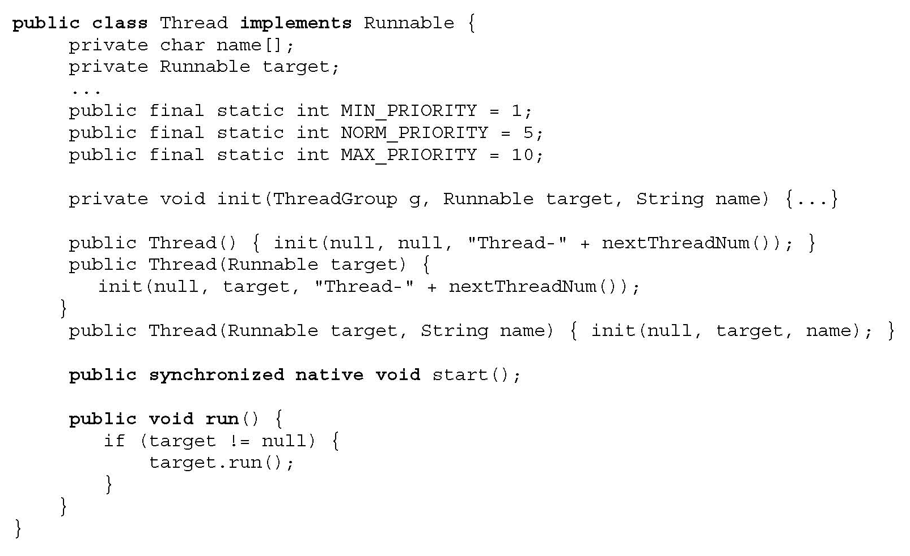
java.lang.Thread
What does
this mean?
Creates execution environment
for the thread
(sets up a separate run-time stack, etc.)

Slide 70
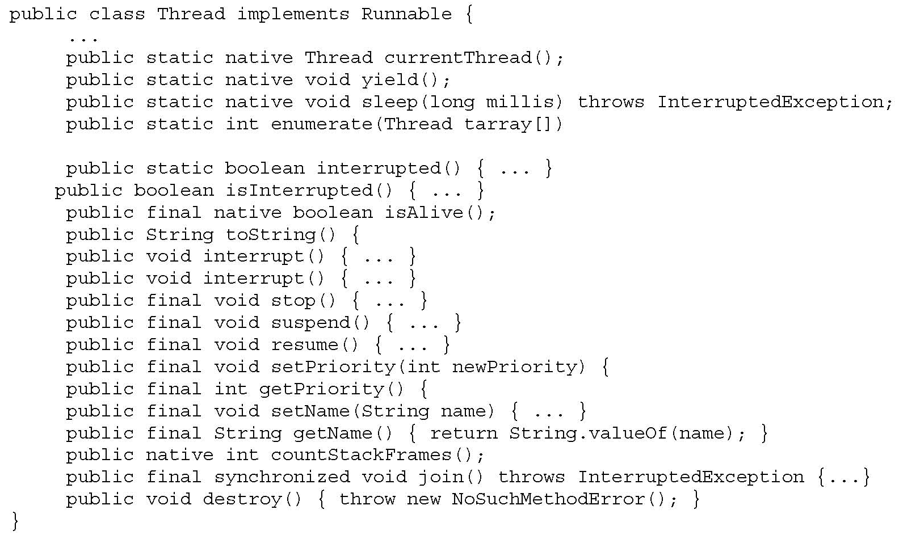
Methods of Thread Class

Slide 71
Runnable Interface
Thread class implements Runnable interface
Single abstract (pure virtual) method run()
public interface Runnable {
public void run(); }
Any implementation of Runnable must provide an implementation of the run() method
public class ConcurrentReader implements Runnable {
…
public void run() { …
… code here executes concurrently with caller … }
}

Slide 72
Two Ways to Start a Thread
Construct a thread with a runnable object
ConcurrReader readerThread = new ConcurrReader();
Thread t = new Thread(readerThread);
t.start(); // calls ConcurrReader.run() automatically
… OR …
Instantiate a subclass of Thread
class ConcurrWriter extends Thread { …
public void run() { … } }
ConcurrWriter writerThread = new ConcurrWriter();
writerThread.start(); // calls ConcurrWriter.run()

Slide 73
Why Two Ways?
Java only has single inheritance
Can inherit from some class, but also implement Runnable interface so that can run as a thread
class X extends Y implements Runnable { …
public synchronized void doSomething() { … }
public void run() { doSomething(); }
}
X obj = new X();
obj.doSomething(); // runs sequentially in current thread
Thread t = new Thread(new X()); // new thread
t.start(); // calls run() which calls doSomething()

Slide 74
Interesting “Feature”
[Allen Holub, “Taming Java Threads”]
Java language specification allows access to objects that have not been fully constructed
class Broken {
private long x;
Broken() {
new Thread() {
public void run() { x = -1; }
}.start();
x = 0;
} }
Thread created within constructor can access partial object

Slide 75
Interaction Between Threads
Shared variables and method calls
Two threads may assign/read the same variable
Programmer is responsible for avoiding race conditions by explicit synchronization!
Two threads may call methods on the same object
Synchronization primitives
All objects have an internal lock (inherited from Object)
Synchronized method locks the object
While it is active, no other thread can execute inside object
Synchronization operations (inherited from Object)
Wait: pause current thread until another thread calls Notify
Notify: wake up waiting thread

Slide 76
Synchronized Methods
Provide mutual exclusion
If a thread calls a synchronized method, object is locked
If another thread calls a synchronized method on the same object, this thread blocks until object is unlocked
Unsynchronized methods can still be called!
“synchronized” is not part of method signature
Subclass may replace a synchronized method with unsynchronized method

Slide 77
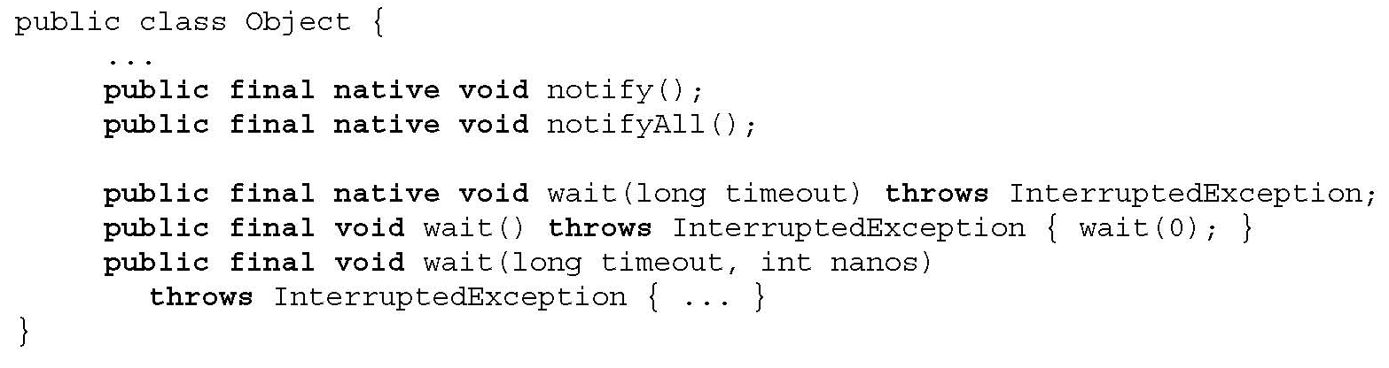
Wait, Notify, NotifyAll
wait() releases object lock, thread waits on internal queue
notify() wakes the highest-priority thread closest to the front of the object’s internal queue
notifyAll() wakes up all waiting threads
Threads non-deterministically compete for access to object
May not be fair (low-priority threads may never get access)
May only be called when object is locked (when is that?)

Slide 78
Using Synchronization
public synchronized void consume() {
while (!consumable()) {
wait(); } // release lock and wait for resource
… // have exclusive access to resource, can consume
}
public synchronized void produce() {
… // do something that makes consumable() true
notifyAll(); // tell all waiting threads to try consuming
// can also call notify() and notify one thread at a time
}

Slide 79
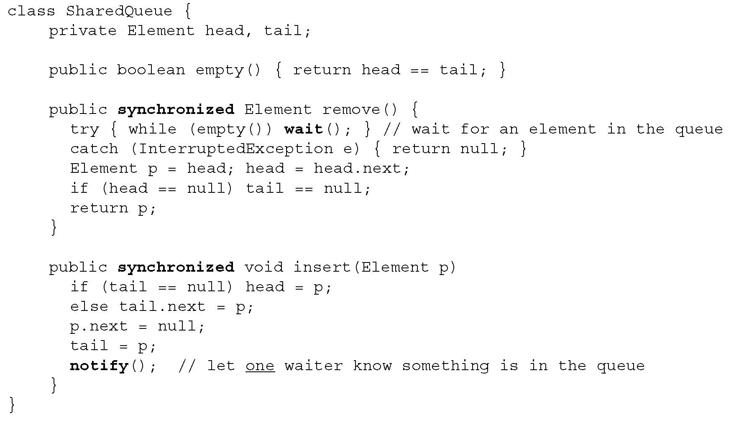
Example: Shared Queue

Slide 80
Example: Producer-Consumer
Producer
Consumer
Producer
Buffer
Consumer
Producer
Consumer
Method call is synchronous
How do we do this in Java?

Slide 81
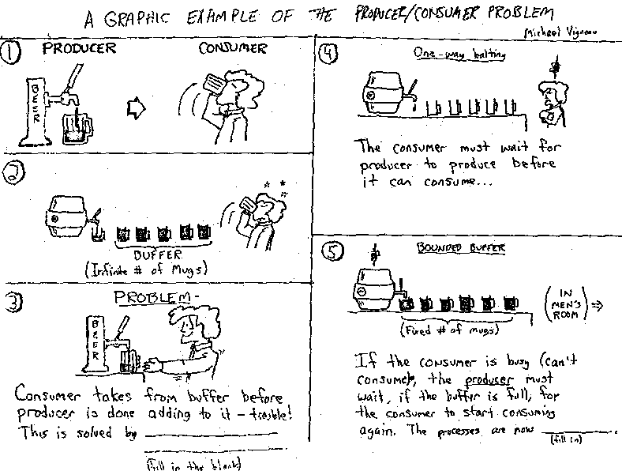
In Pictures
[from Jeffrey Smith]

Slide 82
Solving Producer-Consumer
Cannot be solved with locks alone
Consumer must wait until buffer is not empty
While waiting, must sleep (use wait method)
Need condition recheck loop
Producer must inform waiting consumers when there is something in the buffer
Must wake up at least one consumer (use notify method)

Slide 83
Implementation in Stack<T>
public synchronized void produce (T object) {
stack.add(object); notify();
}
public synchronized T consume () {
while (stack.isEmpty()) {
try {
wait();
} catch (InterruptedException e) { }
}
int lastElement = stack.size() - 1;
T object = stack.get(lastElement);
stack.remove(lastElement);
return object; }
Why is loop needed here?

Slide 84
Condition Rechecks
Want to wait until condition is true
public synchronized void lock() throws InterruptedException {
if ( isLocked ) wait();
isLocked = true; }
public synchronized void unLock() {
isLocked = false;
notify(); }
Need a loop because another process may run instead
public synchronized void lock() throws InterruptedException {
while ( isLocked ) wait();
isLocked = true; }

Slide 85
Nested Monitor Lockout Problem
Wait and notify used within synchronized code
Purpose: make sure that no other thread has called method of same object
Wait causes the thread to give up its lock and sleep until notified
Allow another thread to obtain lock and continue processing
Calling a blocking method within a synchronized method can lead to deadlock

Slide 86
Nested Monitor Lockout Example
class Stack {
LinkedList list = new LinkedList();
public synchronized void push(Object x) { synchronized(list) {
list.addLast( x ); notify();
} }
public synchronized Object pop() { synchronized(list) {
if( list.size() <= 0 ) wait();
return list.removeLast();
} }
}
Could be blocking method of List class
Releases lock on Stack object but not lock on list;
a push from another thread will deadlock

Slide 87
Preventing Nested Monitor Deadlock
No blocking calls in synchronized methods, OR
Provide some nonsynchronized method of the blocking object
No simple solution that works for all programming situations

Slide 88
Synchronized Blocks
Any Java block can be synchronized
synchronized(obj) {
… mutual exclusion on obj holds inside this block …
}
Synchronized method declaration is just syntactic sugar for syncronizing the method’s scope
public synchronized void consume() { … body … }
is the same as
public void consume() {
synchronized(this) { … body … }
}

Slide 89
Locks Are Recursive
A thread can request to lock an object it has already locked without causing deadlock
public class Foo {
public void synchronized f() { … }
public void synchronized g() { … f(); … }
}
Foo f = new Foo;
synchronized(f) { … synchronized(f) { … } … }

Slide 90
Synchronizing with Join()
Join() waits for thread to terminate
class Future extends Thread {
private int result;
public void run() { result = f(…); }
public int getResult() { return result;}
}
…
Future t = new future;
t.start() // start new thread
…
t.join(); x = t.getResult(); // wait and get result

Slide 91
States of a Java Thread
Non-existing
create thread object
destroy
New
start
Runnable
destroy
Thread may not execute any “finally” clauses, leave objects locked
wait, join
notify, notifyAll
thread termination
run method
exits
Blocked
Terminated (Dead)
destroy
garbage collected
and finalization
Non-Existing

Slide 92
Concurrent Garbage Collection
Need to stop thread while mark-and-sweeping
Do other threads need to be stopped?
Problem: objects may change during collection
Solution: prevent read/write to memory area
Subtle!
Generational GC distinguishes short-lived and long-lived objects
Copying collectors allows reads from old area if writes are blocked…

Slide 93
Limitations of Java 1.4 Primitives
Cannot back off an attempt to acquire a lock
Can’t give up after waiting for a certain period of time or after an interrupt
Cannot alter the semantics of a lock
Reentrancy, read versus write protection, fairness, …
No access control for synchronization
Any method can do synchronized(obj) on any object
Synchronization limited to block-structured locking
Can’t acquire a lock in one method, release in another

Slide 94
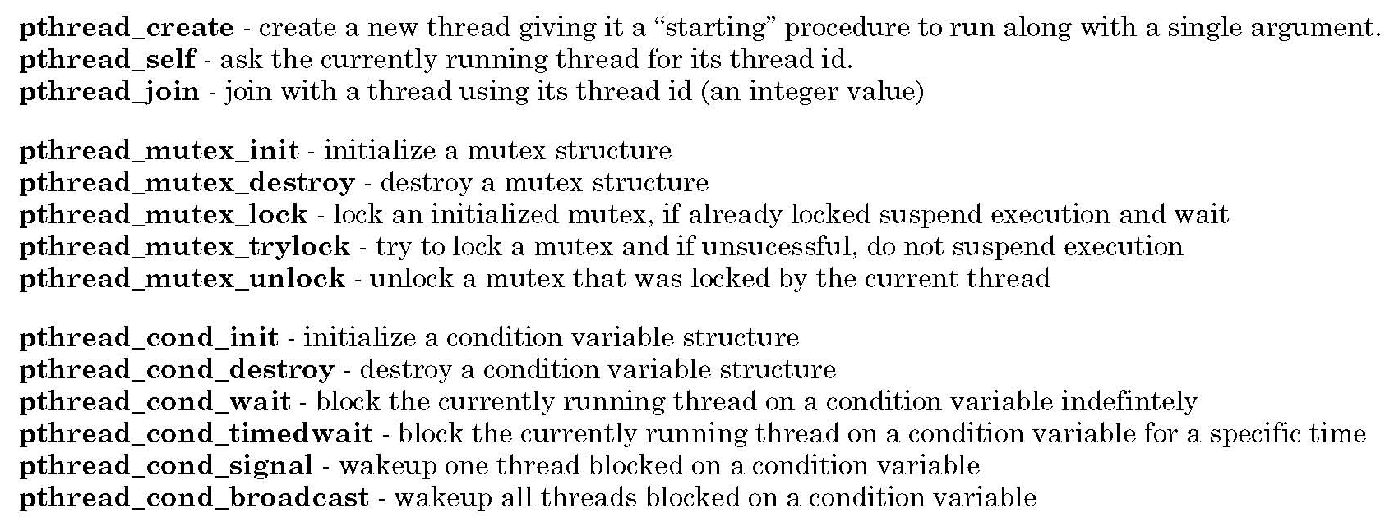
POSIX Threads
Pthreads library for C

Slide 95
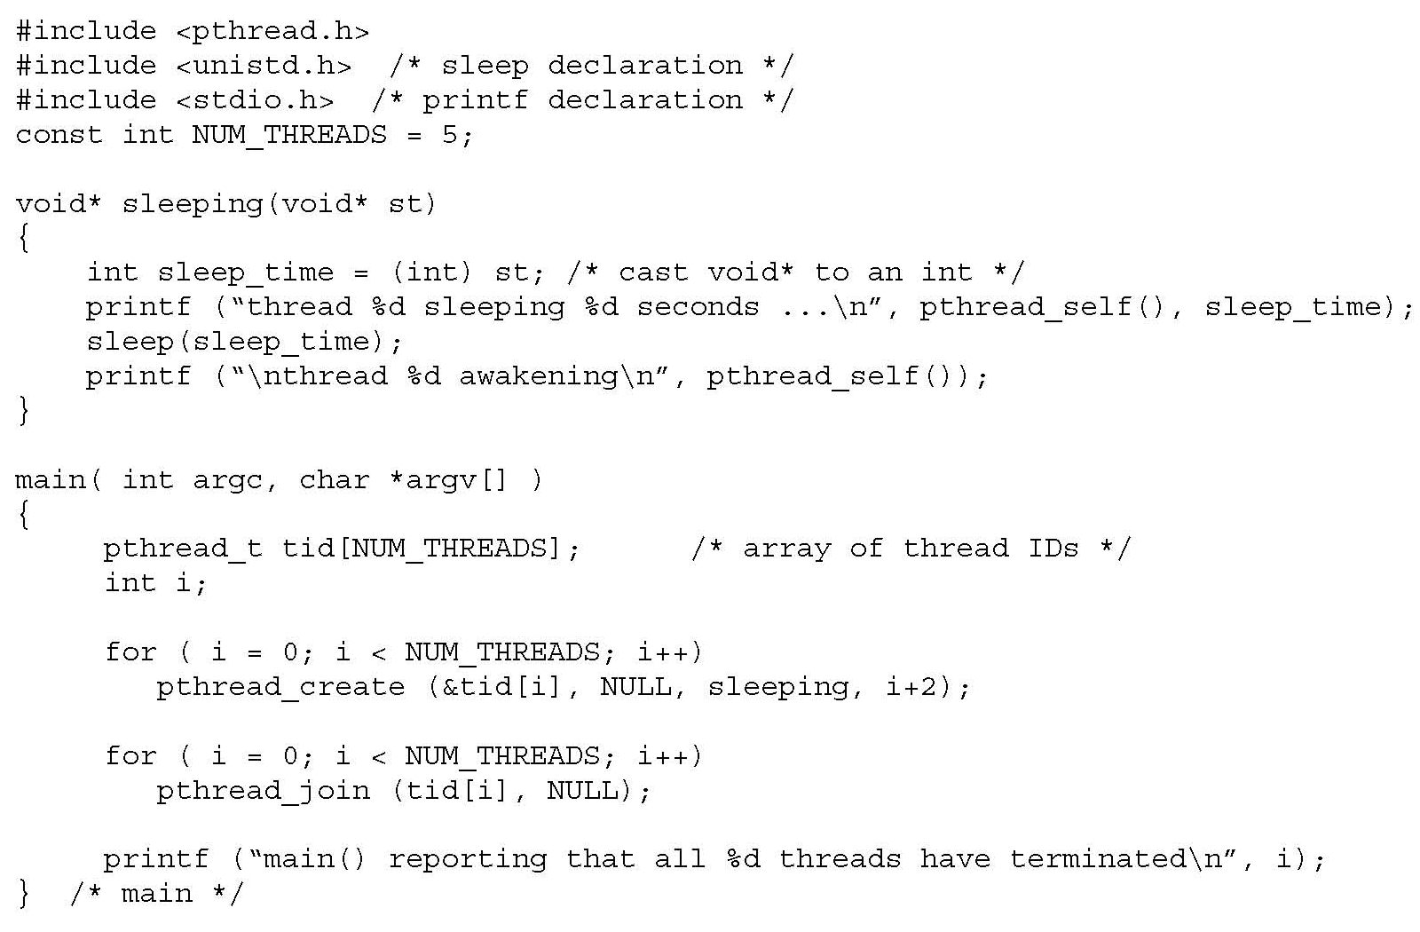
Example of Using POSIX Threads
Create several
child threads
Wait for children to finish

Slide 96
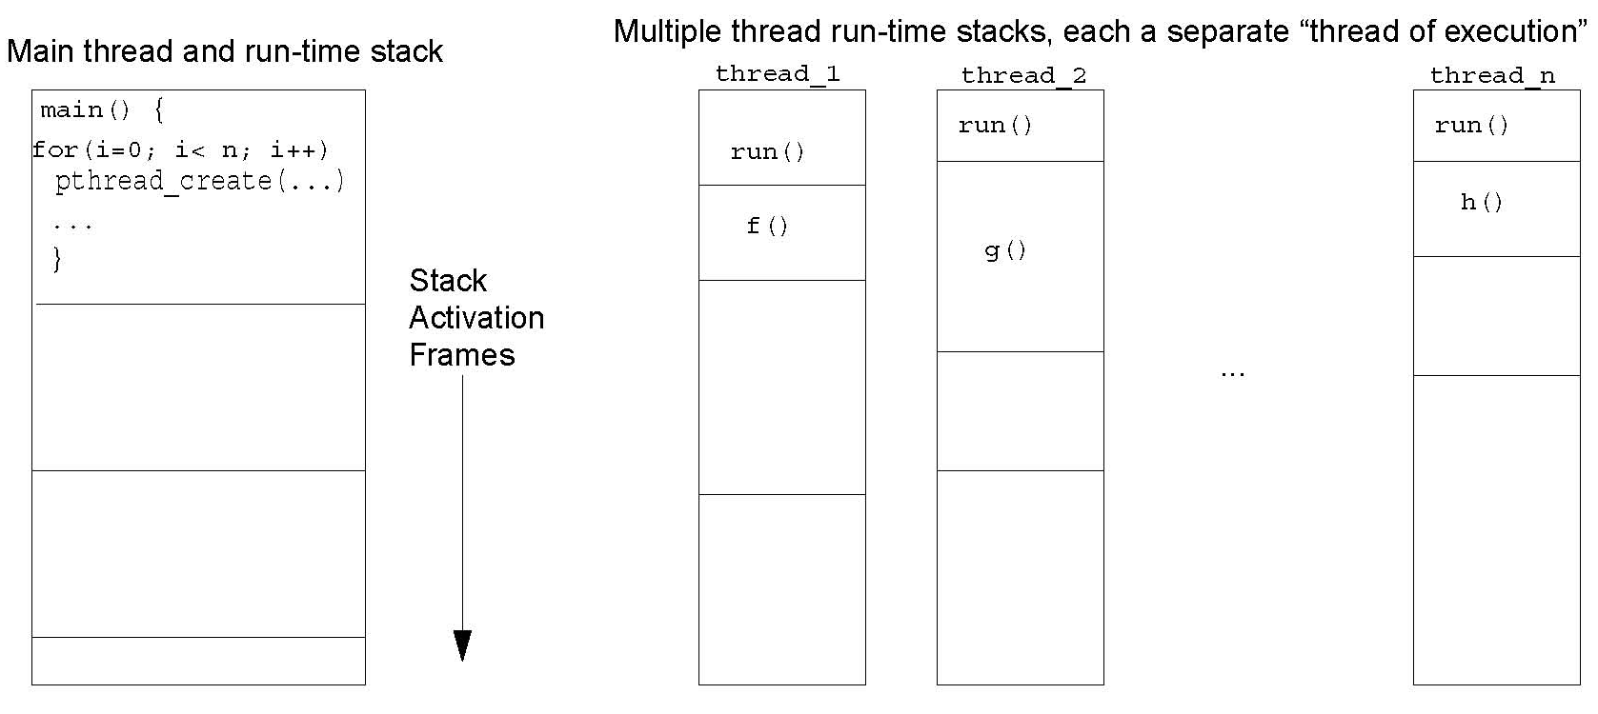
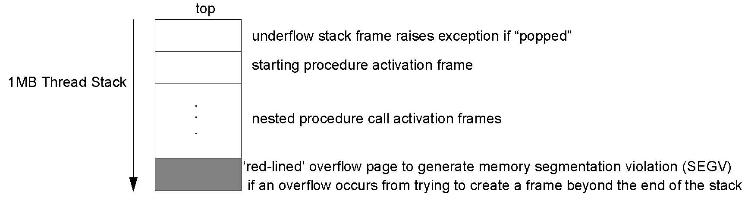
Thread Stacks

Slide 97
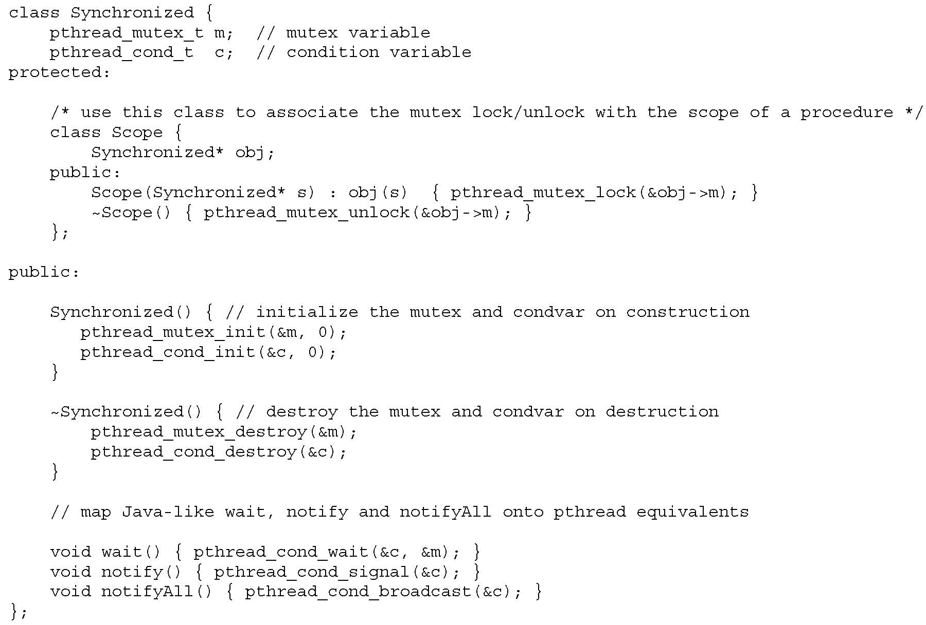
Java-Style Synchronization in C++

Slide 98
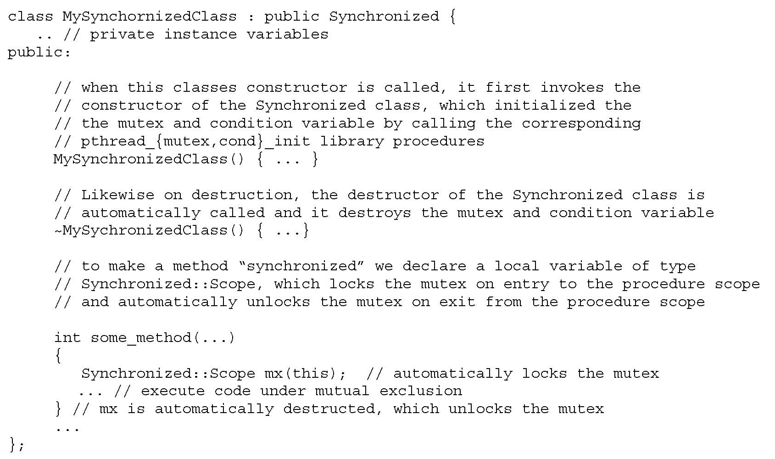
Using C++ Threads

Slide 99
Thread Safety of Classes
Fields of an object or class must always be in a valid state, even when used concurrently by multiple threads
What’s a “valid state”? Serializability …
Classes are designed so that each method preserves state invariants on entry and exit
Example: priority queues represented as sorted lists
If invariant fails in the middle of a method call, concurrent execution of another method call will observe an inconsistent state

Slide 100
Example: RGBColor Class
public class RGBColor {
private int r; private int g; private int b;
public RGBColor(int r, int g, int b) {
checkRGBVals(r, g, b);
this.r = r; this.g = g; this.b = b;
}
private static void checkRGBVals(int r, int g, int b) {
if (r < 0 || r > 255 || g < 0 || g > 255 ||
b < 0 || b > 255) {
throw new IllegalArgumentException();
}
}
}
public void setColor(int r, int g, int b) {
checkRGBVals(r, g, b);
this.r = r; this.g = g; this.b = b;
}
public int[] getColor() {
// returns array of three ints: R, G, B
int[] retVal = new int[3];
retVal[0] = r;
retVal[1] = g;
retVal[2] = b;
return retVal;
}
public void invert() {
r = 255 - r; g = 255 - g; b = 255 - b;
}
What goes wrong with
multi-threaded use of this class?

Slide 101
Problems with RGBColor Class
Write/write conflicts
If two threads try to write different colors, result may be a “mix” of R,G,B from two different colors
Read/write conflicts
If one thread reads while another writes, the color that is read may not match the color before or after

Slide 102
Making Classes Thread-Safe
Synchronize critical sections
Make fields private, synchronize access to them
Make objects immutable
State cannot be changed after object is created
public RGBColor invert() {
RGBColor retVal = new RGBColor(255 - r, 255 - g, 255 - b);
return retVal; }
Examples: Java String and primitive type wrappers Integer, Long, Float, etc.
Pure functions are always re-entrant!
Use a thread-safe wrapper

Slide 103
Thread-Safe Wrapper
Define new class which has objects of original class as fields, provides methods to access them
public synchronized void setColor(int r, int g, int b) {
color.setColor(r, g, b);
}
public synchronized int[] getColor() {
return color.getColor();
}
public synchronized void invert() {
color.invert();
}

Slide 104
Comparison
Synchronizing critical sections
Good way to build thread-safe classes from scratch
Only way to allow wait() and notify()
Using immutable objects
Good if objects are small, simple abstract data types
Benefits: pass without aliasing, unexpected side effects
Using wrapper objects
Works with existing classes, gives users choice between thread-safe version and original (unsafe) one
Example: Java 1.2 collections library – classes not thread-safe, but some have methods to enclose objects in safe wrapper

Slide 105
Why Not Synchronize Everything?
Performance costs
Current Sun JVM – synchronized methods are 4 to 6 times slower than non-synchronized
Risk of deadlock from too much locking
Unnecessary blocking and unblocking of threads can reduce concurrency
Alternative: immutable objects
Issue: often short-lived, increase garbage collection

Slide 106
Inheritance Anomaly
Inheritance and concurrency do not mix well
Inheritance anomaly identified in 1993 (before Java)
Arises in different languages, to different degrees, depending on concurrency primitives
Concurrency control in derived classes requires redefinition of base class and parents
Concurrency control = synchronization, waiting, etc.
Modification of class requires modifications of seemingly unrelated features in parent classes

Slide 107
Examples of Inheritance Anomaly
Partitioning of acceptable states
Method can only be entered in certain states (enforced by base class)
New method in derived class changes set of states
Must redefine base class method to check new states
History-sensitive method entry
New method in derived class can only be called after other calls
Must modify existing methods to keep track of history

Slide 108
Example: Buffer Class
public class Buffer {
protected Object[] buf; protected int MAX; protected int current = 0;
Buffer(int max) {
MAX = max;
buf = new Object[MAX]; }
public synchronized Object get() throws Exception {
while (current<=0) { wait(); }
current--;
Object ret = buf[current];
notifyAll();
return ret; }
public synchronized void put(Object v) throws Exception {
while (current>=MAX) { wait(); }
buf[current] = v;
current++;
notifyAll(); } }

Slide 109
Problems in Derived Class
public class HistoryBuffer extends Buffer {
boolean afterGet = false;
public HistoryBuffer(int max) { super(max); }
public synchronized Object gget() throws Exception {
while ((current<=0)||(!afterGet)) { wait(); }
afterGet = false;
return super.get(); }
public synchronized Object get() throws Exception {
Object o = super.get();
afterGet = true;
return o; }
public synchronized void put(Object v) throws Exception {
super.put(v);
afterGet = false; } }
New method, can be called only after get
Must be redefined to keep track of last method called
Need to redefine to keep track of last method called

Slide 110
util.concurrent
Doug Lea’s utility classes
A few general-purpose interfaces
Implementations tested over several years
Principal interfaces and implementations
Sync: acquire/release protocols
Channel: put/take protocols
Executor: executing Runnable tasks

Slide 111
Sync
Main interface for acquire/release protocols
Used for custom locks, resource management, other common synchronization idioms
Coarse-grained interface, doesn’t distinguish different lock semantics
Implementations
Mutex, ReentrantLock, Latch, CountDown, Semaphore, WaiterPreferenceSemaphore, FIFOSemaphore, PrioritySemaphore
ObservableSync, LayeredSync to simplify composition and instrumentation

Slide 112
Channel
put, offer
take, poll
Producer
Channel
Consumer
Main interface for buffers, queues, etc.
Implementations
LinkedQueue, BoundedLinkedQueue, BoundedBuffer, BoundedPriorityQueue, SynchronousChannel, Slot

Slide 113
Executor
Main interface for Thread-like classes
Pools
Lightweight execution frameworks
Custom scheduling
Need only support execute(Runnable r)
Analogous to Thread.start
Implementations
PooledExecutor, ThreadedExecutor, QueuedExecutor, FJTaskRunnerGroup
Related ThreadFactory class allows most Executors to use threads with custom attributes

Slide 114
java.util.Collection
Adapter-based scheme
Allow layered synchronization of collection classes
Basic collection classes are unsynchronized
Example: java.util.ArrayList
Except for Vector and Hashtable
Anonymous synchronized Adapter classes
Constructed around the basic classes, e.g.,
List l = Collections.synchronizedList(new ArrayList());

Slide 115
Java Memory Model
Multithreaded access to shared memory
Competitive threads access shared data
Can lead to data corruption
Memory model determines:
Which program transformations are allowed
Should not be too restrictive
Which program outputs may occur on correct implementation
Should not be too generous
Need semantics for incorrectly synchronized programs

Slide 116
Memory Hierarchy
Shared Memory
Thread
Cache
code
read/write
load/store
use/assign
Thread
Cache
code
Old memory model placed complex constraints on read, load, store, etc.

Slide 117
Program and Locking Order
[Manson, Pugh]
Thread 1
Thread 2
y = 1
lock M
lock M
program
order
lock
sync
program
order
x = 1
i = x
unlock M
unlock M
j = y

Slide 118
Race Conditions
“Happens-before” order
Transitive closure of program order and synchronizes-with order (what does this mean?)
Program order as written or as compiled and optimized?
Conflict
An access is a read or a write
Two accesses conflict if at least one is a write
Race condition
Two accesses form a data race if they are from different threads, they conflict, and they are not ordered by happens-before

Slide 119

Races in Action
Northeast Blackout of 2003
Affected 50 million people in U.S. and Canada
Race condition in alarm management system caused it to stall, alarms backed up and stalled both primary and backup server
“We had in excess of three million online operational hours in which nothing had ever exercised that bug. I'm not sure that more testing would have revealed it.”
-- GE Energy's Mike Unum
Notes:
119

Slide 120
Memory Model Question
How should the compiler and run-time system be allowed to schedule instructions?
Possible partial answer
If instruction A occurs in Thread 1 before release of lock, and B occurs in Thread 2 after acquire of same lock, then A must be scheduled before B
Does this solve the problem?
Too restrictive: if no reordering allowed in threads
Too permissive: if arbitrary reordering in threads
Compromise: allow local thread reordering that would be OK for sequential programs

Slide 121
Instruction Reordering
Compilers can reorder instructions
If two instructions are independent, do in any order
Take advantage of registers, etc.
Correctness for sequential programs
Observable behavior should be same as if program instructions were executed in the order written
Sequential consistency for concurrent programs
If program has no data races, then memory model should guarantee sequential consistency
What about programs with races?
Reasonable programs may have races (need to test, debug, …)

Slide 122
Example Program with Data Race
[Manson, Pugh]
x = y = 0
Thread 1
start threads
Thread 2
x = 1
y = 1
j = y
i = x
Can we end up with i = 0 and j = 0?
Notes:
122

Slide 123
Sequential Reordering + Data Race
[Manson, Pugh]
x = y = 0
Thread 1
start threads
Thread 2
x = 1
y = 1
OK to reorder
single thread
OK to reorder
single thread
j = y
i = x
Can we end up with i = 0 and j = 0? Yes!
Java definition considers this OK since there is a data race
Notes:
123

Slide 124
Allowed Sequential Reordering
[Manson, Pugh]
“Roach motel” ordering
Compiler/processor can move accesses into synchronized blocks
Can only move them out under special circumstances, generally not observable
Release only matters to a matching acquire
Special cases:
Locks on thread local objects are a no-op
Reentrant locks are a no-op
Java SE 6 (Mustang) optimizes based on this

Slide 125
Want To Prevent This
[Manson, Pugh]
x = y = 0
r1 = x
r2 = y
y = r1
x = r2
Must not result in r1 = r2 = 42
Imagine if 42 were a reference to an object!
Value appears “out of thin air”
Causality run amok
Legal under a simple “happens-before” model of possible behaviors

Slide 126
Summary of Memory Model
Strong guarantees for race-free programs
Equivalent to interleaved execution that respects synchronization actions
Reordering must preserve thread’s sequential semantics
Weaker guarantees for programs with races
No weird out-of-the-blue program results
Allows program transformation and optimization
Form of actual memory model definition
Happens-before memory model
Additional condition: for every action that occurs, there must be identifiable cause in the program

Slide 127
Example: Concurrent Hash Map
Implements a hash table
Insert and retrieve data elements by key
Two items in same bucket placed in linked list
Tricky
“ConcurrentHashMap is both a very useful class for many concurrent applications and a fine example of a class that understands and exploits the subtle details of the Java Memory Model (JMM) to achieve higher performance. … Use it, learn from it, enjoy it – but unless you're an expert on Java concurrency, you probably shouldn't try this on your own.”

Slide 128
ConcurrentHashMap
Array
Linked lists
Data
Data
Data
Data
Data
Data
Data
Data
Data
Concurrent operations
read: no problem
read/write: OK if different lists
read/write to same list: clever tricks sometimes avoid locking

Slide 129
ConcurrentHashMap Tricks
Array
Linked lists
Data
Data
Data
List cells immutable, except for data field
Read thread sees a linked list, even if concurrent write in progress
Add to list by inserting at the head
Remove from list: set data field to null, rebuild list to skip this cell
Unreachable cells eventually garbage collected

Slide 130
Atomicity
Mark block so that compiler and run-time system will execute it without interaction from other threads
Advantages
Simple, powerful correctness property
Stronger than race freedom (why?)
Enables sequential reasoning
Notes:
130

Slide 131
Limitations of Race-Freedom (1)
[Flanaghan]
class Ref {
int i;
void inc() {
int t;
synchronized (this) {
t = i;
}
synchronized (this) {
i = t+1;
}
}
...
}
Ref.inc()
Race-free
Behaves incorrectly in a multithreaded context
Race freedom does not prevent errors due to unexpected interactions
between threads

Slide 132
Limitations of Race-Freedom (2)
[Flanaghan]
class Ref {
int i;
void inc() {
int t;
synchronized (this) {
t = i;
i = t+1;
}
}
void read() { return i; }
...
}
Ref.read()
Has a race condition
Behaves correctly in a multithreaded context
Race freedom is not necessary to prevent errors due to unexpected interactions
between threads

Slide 133
Atomicity
[Flanaghan]
An easier-to-use and harder-to-implement primitive:
void deposit(int x){
synchronized(this) {
int tmp = balance;
tmp += x;
balance = tmp;
}}
void deposit(int x){
atomic {
int tmp = balance;
tmp += x;
balance = tmp;
}}
semantics:
lock acquire/release
semantics:
(behave as if)
no interleaved execution
No fancy hardware, code restrictions, deadlock, or unfair scheduling (e.g., disabling interrupts)
Notes:
133

Slide 134
AtomJava
[Grossman]
New prototype from the University of Washington
Based on source-to-source translation for Java
Atomicity via locking (object ownership)
Poll for contention and rollback
No support for parallel readers yet
Key pieces of the implementation
All writes logged when an atomic block is executed
If thread is pre-empted in atomic, rollback the thread
Duplicate so non-atomic code is not slowed by logging
Smooth interaction with GC

Slide 135
2. Multithreading programming

Slide 136
Creating Threads
Two ways to create threads
Subclassing Thread
class MyThread extends Thread {
public void run() {
// do the work
}
}
public class UsingThreads {
public void someFunction() {
MyThread t = new MyThread();
t.start();
}
}
Implementing Runnable
class MyRunnable implements Runnable {
public void run() {
// do the work
}
}
public class UsingThreads {
public void someFunction() {
Thread t = new Thread(new MyRunnable());
t.start();
}
}

Slide 137
Threads Basics
Thread@start() starts a new thread which executes the run() method
A thread stops when run() completes
A Thread object can only be started once
Don’t override start()
Methods of a Thread/Runnable can be called just like method of regular objects.

Slide 138
Threads Basics
start() can only be called once on a Thread.
class MyThread extends Thread {
public void run() {
// do the work
}
}
public class UsingThreads {
public void someFunction() {
MyThread t = new MyThread();
t.start();
t.start(); //IllegalThreadStateException
}
}

Slide 139
Threads Basics
Main() {
Thread t = new MyThread();
t.start();
// do work 1
Main() {
Thread t = new MyThread();
t.run();
// do work 1
main thread
new thread
main thread
new thread
start()
main()
None
main()
run()
run()

Slide 140
Threads Basics
class MyThread extends Thread {
public void run() {
// work 1
method();
}
public void method() {
// work 2
}
}
class MainThread {
void main(...) {
MyThread t = new MyThread();
t.start();
t.join();
t.method();
main thread
new thread
main()
start()
run()
method()
method()
t.method() called by
main() runs in the
thread of the caller
t.run() & t.method()
called by run()
run in its own thread

Slide 141
Threads Basics
class MyThread extends Thread {
public void run() {
// work 1
function();
}
public void method() {
// work 2
}
}
class OtherThread extends Thread {
void function(...) {
Thread t = new MyThread();
t.start();
one thread
new thread
start()
function()
run()
method()
Any thread or any method can create and start a new Thread

Slide 142
Threads Basics - join
One thread can wait for another thread to complete
class MyThread extends Thread {
public void run() {
// work 1
function();
}
}
class MainThread {
void main(...) {
Thread t = new MyThread();
t.start();
t.join(); // wait until t completes
// to be executed after t completes

Slide 143
Monitor in Java
Each instance of Object has two types of operations
Synchronized operations
Normal operations
Consider all synchronized operations together as a room
Only one thread can enter the room
All other threads which want to enter must wait
One of the waiting threads is chosen to enter when the current thread exits the room
Normal operations can be called and executed in any thread at any time.
They may be called by the thread in the room
They may be called by any thread at any place
They may be executed concurrently or in any arbitrary order

Slide 144
Monitor in Java
t3
Thread ti
Thread ti
t2
op1
op1
t1
op2
op2
No thread in the room, the door is open
Thread ti is in the room, the door is closed/locked
Thread ti is in the room, t1, t2, and t3 must wait until ti is out of the room

Slide 145
An Example of Monitor
ThreadSafeStack and ThreadUnsafeStack are identical except push, pop, and size in ThreadSafeStack are synchronized
ThreadSafeStack is thread-safe – no race condition problem when accessed by multiple threads concurrently
Only one thread can executed push or pop at a time, not concurrently.
ThreadUnsafeStack is not thread-safe. Can you see that the size variable may be incremented only by one after two threads have pushed two items into the stack?

Slide 146
An Example of Monitor
class ThreadUnsafeStack {
private ArrayList<Integer> stack;
private int size = 0;
public ThreadUnsafeStack() {
stack = new ArrayList<Integer>();
}
public void push(Integer item) {
stack.add(item);
size++;
}
public Integer pop() {
Integer top = null;
if (size()>0) {
top = stack.remove(0);
size--;
}
return top;
}
public int size() {
return size;
}
}

Slide 147
An Example of Monitor
class ThreadSafeStack {
private ArrayList<Integer> stack;
private int size = 0;
public ThreadSafeStack() {
stack = new ArrayList<Integer>();
}
public synchronized void push(Integer item) {
stack.add(item);
size++;
}
public synchronized Integer pop() {
Integer top = null;
if (size()>0) {
top = stack.remove(0);
size--;
}
return top;
}
public synchronized int size() {
return size;
}
}

Slide 148
An Example of Monitor
public class Tester {
public static void main(String[] args) {
ThreadSafeStack stack = new ThreadSafeStack();
Thread t1 = new MyThread(stack, 100);
Thread t2 = new MyThread(stack, 200);
t1.start();
t2.start();
try { t1.join(); } catch (InterruptedException e) {}
try { t2.join(); } catch (InterruptedException e) {}
}
}
class MyThread extends Thread {
private ThreadSafeStack stack;
private int startVal;
public MyThread(ThreadSafeStack stack, int startVal) {
this.stack = stack;
this.startVal = startVal;
}
public void run() {
for (int i = 0; i < 10; i++) {
stack.push(i + startVal);
System.out.println("Pushed in: " + startVal);
try { sleep(1000); } catch (InterruptedException e) {}
}
int value;
for (int i = 0; i < 10; i++) {
value = stack.pop();
System.out.println("Popped out: " + value);
System.out.println(value);
try { sleep(1000); } catch (InterruptedException e) {}
}
}
}

Slide 149
Synchronized Blocks
Java allows program blocks to form a monitor by synchronizing on the object.
Accesses to counter1 are synchronized on monitor1
Accesses to counter2 are synchronized on monitor
Since Object is the superclass of every class, so you can synchronize on any object of any class.
class SyncBlocks {
Object monitor1 = new Object();
Object monitor2 = new Object();
private int counter1;
private int counter2;
public void incCounter1() {
synchronized(monitor1) {
counter1++;
}
}
public void decCounter1() {
synchronized(monitor1) {
counter1++;
}
}
public void incCounter2() {
synchronized(monitor2) {
counter2++;
}
}
public void decCounter2() {
synchronized(monitor2) {
counter2++;
}
}
}

Slide 150
Synchronized Blocks
t3
monitor2
monitor1
Thread ti
t2
incCounter1
incCounter2
t1
decCounter1
decCounter2
No one is executing incCounter1() and decCounter1(), the door is open
Thread ti is executing incCounter2(), t1, t2, and t3 must wait until ti completes the operation.

Slide 151
Wait and notify
Each monitor in Java has one implicit Condition threads can wait on by calling Object.wait()
When the thread calls wait(), it opens the door and puts itself to the waiting list of the Condition.
The thread in the room may call Object.notify() to move one thread waiting on the Condition to the waiting list by the door, or Object.notifyAll() to move all threads waiting on the Condition to the waiting list by the door.
Wait(), notify(), and notifyAll() must be called from a synchronized method or block

Slide 152
An Example of Join/Notify
class BoundedBuffer {
private int count = 0;
private int[] buffer = new int[10];
private int cursor = 0;
public synchronized void deposit(Integer item) {
// if the buffer is full, wait on Condition
while (count >= 10)
try { wait(); } catch (InterruptedException e) {};
buffer[cursor] = item;
cursor = (cursor + 1) % 10;
count++;
// if is was empty, notify all waiting threads
if (count == 1) notifyAll();
}
public synchronized int remove() {
// if the buffer is empty, wait on Condition
while (count == 0)
try { wait(); } catch (InterruptedException e) {}
int item = buffer[cursor];
cursor = (cursor - 1 + 10) % 10;
count--;
// if it was full, notify all waiting threads
if (count == 9) notifyAll();
return item;
}
}

Slide 153
An Example of Join/Notify
tz
buffer
ty
Thread ti
t3
deposit()
t2
tx
t1
remove()
Condition
Threads tx, ty, tz called remove() on an empty buffer, so they are in the waiting list of the Condition. Thread ti is executing deposit(). When ti calls notifyAll(), tx, ty, and tz are moved to the waiting list by the door.
When ti leaves deposit(), the door will be open and one of the 6 waiting threads is randomly chosen to enter the room and the door will be closed again.

Slide 155
Threads Concept
Multiple threads on multiple CPUs
Multiple threads sharing a single CPU

Slide 156
Creating Tasks and Threads

Slide 157
Example: Using the Runnable Interface to Create and Launch Threads
Objective: Create and run three threads:
The first thread prints the letter a 10 times.
The second thread prints the letter b 10 times.
The third thread prints the integers 1 through 10.

Slide 158
Example: Three Threads 1/3
package csu.matos;
public class Driver {
public static void main(String[] args) {
// Create tasks
Runnable printA = new PrintChar('a', 10);
Runnable printB = new PrintChar('b', 10);
Runnable print10 = new PrintNum(10);
// Create threads
Thread thread1 = new Thread(printA);
Thread thread2 = new Thread(printB);
Thread thread3 = new Thread(print10);
// Start threads
thread1.start();
thread2.start();
thread3.start();
}
}

Slide 159
Example: Three Threads 1/3
// The task for printing a specified character in specified times
class PrintChar implements Runnable {
private char charToPrint; // The character to print
private int times; // The times to repeat
public PrintChar(char c, int t) {
charToPrint = c;
times = t;
}
public void run() {
for (int i = 0; i < times; i++) {
System.out.print(charToPrint);
}
}//run
}//PrintChar

Slide 160
Example: Three Threads 1/3
// The task class for printing number from 1 to n for a given n
class PrintNum implements Runnable {
private int lastNum;
/** Construct a task for printing 1, 2, ... i */
public PrintNum(int n) {
lastNum = n;
}
/** Tell the thread how to run */
public void run() {
for (int i = 1; i <= lastNum; i++) {
System.err.print("" + i);
}
}//run
}//PrintNum
Sample output
aaaaaaaaaabbbb123bbbbbb45678910
Aaaaaaaaaa12345678910bbbbbbbbbb
123456789aaaaaaaaaabbbbbbbbbb10

Slide 161
The Thread Class

Slide 162
The Static yield() Method
You can use the yield() method to temporarily release time for other threads. For example, suppose you modify the previous printNum class as follows:
public void run() {
for (int i = 1; i <= lastNum; i++) {
System.out.print(" " + i);
Thread.yield();
}
}
Every time a number is printed, the print10 thread is yielded.
So, the numbers are printed after the characters.
Sample Output
aaaaaaaaaabbb 1b 2 3 4b 5 6 7 8b 9 10 bbbb
aaaaaaaaaa 1 2b 3b 4b 5b 6b 7b 8b 9b 10bb

Slide 163
The Static sleep(milliseconds) Method
The sleep(long mills) method puts the thread to sleep for the specified time in milliseconds. For example, suppose you modify the code in PrintNum class as follows:
public void run() {
for (int i = 1; i <= lastNum; i++) {
System.out.print(" " + i);
try {
if (i >= 5) Thread.sleep(1);
}
catch (InterruptedException ex) {
}
}
}
Every time a number (>= 5) is printed, the print10 thread is put to sleep for 1 millisecond.
Sample output
aaaa 1 2 3 4 5aaaaaabbbbbbbbbb 6 7 8 9 10

Slide 164
The join() Method
You can use the join() method to force one thread to wait for another thread to finish. For example, suppose you modify the previous PrintNum class as follows:
The numbers after 5 are printed after Thread4 is finished.
Sample output
bbbbbbbbbba 1 2 3 4 5aaaaaccccccccccccccccccccccccccccccccccccccccaaaa 6 7 8 9 10

Slide 165
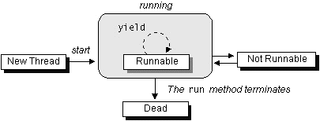
Thread Life Cycle
New state - Before the start() method invocation. The thread is considered not alive.
Runnable (Ready-to-run) state - On this state a thread is waiting for a turn on processor. Begins after invoking start() method. A thread can return to this state after either running, waiting, sleeping or coming back from blocked state also.
Running state - The thread is currently executing. The scheduler selects arbitrarily a thread from runnable pool.
Dead state - Dead state begins when its run() method completes.
Blocked - A thread is waiting the resources that are held by another thread(s).

Slide 166
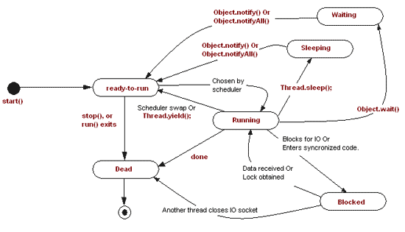
Thread Life Cycle

Slide 167
isAlive(), interrupt(), and isInterrupted()
The isAlive() method is used to find out the state of a thread.
It returns true if a thread is in the Ready, Blocked, or Running state;
It returns false if a thread is new and has not started or if it is finished.
The interrupt() method interrupts a thread in the following way:
If a thread is currently in the Ready or Running state, its interrupted flag is set;
if a thread is currently blocked, it is awakened and enters the Ready state, and an java.io.InterruptedException is thrown.
The isInterrupt() method tests whether the thread is interrupted.

Slide 168

The deprecated: stop(), suspend(), and resume() Methods
NOTE1:
The Thread class also contains the stop(), suspend(),
and resume() methods.
As of Java 2, these methods are deprecated (or outdated) because they are known to be inherently unsafe.
NOTE2:
You should assign null to a Thread variable to indicate that it is stopped rather than use the stop() method.

Slide 169
Thread Priority
Each thread is assigned a default priority of
Thread.NORM_PRIORITY.
You can reset the priority using:
setPriority(int priority).
Some constants for priorities include:
Thread.MIN_PRIORITY
Thread.MAX_PRIORITY
Thread.NORM_PRIORITY

Slide 170
GUI Event Dispatcher Thread
GUI event handling and painting code executes in a single thread, called the event dispatcher thread.
This ensures that each event handler finishes executing before the next one executes and the painting isn’t interrupted by events.

Slide 171
invokeLater and invokeAndWait
You may run your code in the event dispatcher thread
Use the static methods, invokeLater and invokeAndWait, in the javax.swing.SwingUtilities class to run the code in the event dispatcher thread.
You must put this code in the run method of a Runnable object.
The invokeLater method returns immediately, without waiting for the event dispatcher thread to execute the code.
The invokeAndWait method is just like invokeLater, except that invokeAndWait doesn't return until the event-dispatching thread has executed the specified code.

Slide 172
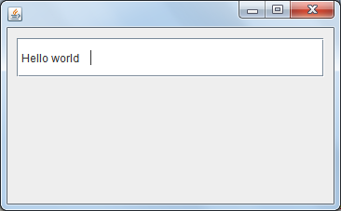
Launch Application from Main Method
import java.awt.EventQueue;
import javax.swing.*;
public class MyFrame1 extends JFrame {
private JTextField textField1;
public static void main(String[] args) {
EventQueue.invokeLater(new Runnable() {
public void run() {
try {
MyFrame1 frame = new MyFrame1();
frame.setVisible(true);
} catch (Exception e) {
e.printStackTrace();
}
}
});
}
public MyFrame1() {
setDefaultCloseOperation(JFrame.EXIT_ON_CLOSE);
setBounds(100, 100, 366, 227);
getContentPane().setLayout(null);
textField1 = new JTextField();
textField1.setBounds(10, 11, 330, 42);
getContentPane().add(textField1);
textField1.setColumns(10);
textField1.setText(" Hello world");
}
}

Slide 173
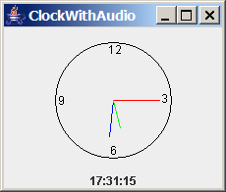
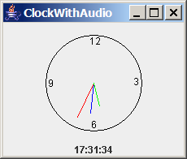
Case Study: Clock with Audio (Optional)
The example creates an applet that displays a running clock and announces the time at one-minute intervals. For example, if the current time is 6:30:00, the applet announces, "six o’clock thirty minutes a.m." If the current time is 20:20:00, the applet announces, "eight o’clock twenty minutes p.m." Also add a label to display the digital time.
ClockWithAudio
Run

Slide 174
Run Audio on Separate Thread
When you run the preceding program, you will notice that the second hand does not display at the first, second, and third seconds of the minute. This is because sleep(1500) is invoked twice in the announceTime() method, which takes three seconds to announce the time at the beginning of each minute. Thus, the next action event is delayed for three seconds during the first three seconds of each minute. As a result of this delay, the time is not updated and the clock was not repainted for these three seconds. To fix this problem, you should announce the time on a separate thread. This can be accomplished by modifying the announceTime method.
ClockWithAudioOnSeparateThread
Run

Slide 175
Thread Pools
Starting a new thread for each task could limit throughput and cause poor performance. A thread pool is ideal to manage the number of tasks executing concurrently. JDK 1.5 uses the Executor interface for executing tasks in a thread pool and the ExecutorService interface for managing and controlling tasks. ExecutorService is a subinterface of Executor.

Slide 176
Creating Executors
To create an Executor object, use the static methods in the Executors class.
ExecutorDemo
Run

Slide 177
Thread Synchronization
A shared resource may be corrupted if it is accessed simultaneously by multiple threads. For example, two unsynchronized threads accessing the same bank account may cause conflict.

Slide 178
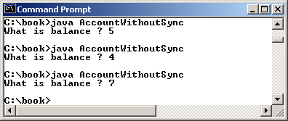
Example: Showing Resource Conflict
Objective: Write a program that demonstrates the problem of resource conflict. Suppose that you create and launch one hundred threads, each of which adds a penny to an account. Assume that the account is initially empty.
AccountWithoutSync
Run

Slide 179
Race Condition
What, then, caused the error in the example? Here is a possible scenario:
The effect of this scenario is that Task 1 did nothing, because in Step 4 Task 2 overrides Task 1's result. Obviously, the problem is that Task 1 and Task 2 are accessing a common resource in a way that causes conflict. This is a common problem known as a race condition in multithreaded programs. A class is said to be thread-safe if an object of the class does not cause a race condition in the presence of multiple threads. As demonstrated in the preceding example, the Account class is not thread-safe.

Slide 180
The synchronized keyword
To avoid race conditions, more than one thread must be prevented from simultaneously entering certain part of the program, known as critical region. The critical region in the Listing 29.7 is the entire deposit method. You can use the synchronized keyword to synchronize the method so that only one thread can access the method at a time. There are several ways to correct the problem in Listing 29.7, one approach is to make Account thread-safe by adding the synchronized keyword in the deposit method in Line 45 as follows:
public synchronized void deposit(double amount)

Slide 181
Synchronizing Instance Methods and Static Methods
A synchronized method acquires a lock before it executes. In the case of an instance method, the lock is on the object for which the method was invoked. In the case of a static method, the lock is on the class. If one thread invokes a synchronized instance method (respectively, static method) on an object, the lock of that object (respectively, class) is acquired first, then the method is executed, and finally the lock is released. Another thread invoking the same method of that object (respectively, class) is blocked until the lock is released.

Slide 182
Synchronizing Instance Methods and Static Methods
With the deposit method synchronized, the preceding scenario cannot happen. If Task 2 starts to enter the method, and Task 1 is already in the method, Task 2 is blocked until Task 1 finishes the method.

Slide 183
Synchronizing Statements
Invoking a synchronized instance method of an object acquires a lock on the object, and invoking a synchronized static method of a class acquires a lock on the class. A synchronized statement can be used to acquire a lock on any object, not just this object, when executing a block of the code in a method. This block is referred to as a synchronized block. The general form of a synchronized statement is as follows:
synchronized (expr) {
statements;
}
The expression expr must evaluate to an object reference. If the object is already locked by another thread, the thread is blocked until the lock is released. When a lock is obtained on the object, the statements in the synchronized block are executed, and then the lock is released.

Slide 184
Synchronizing Statements vs. Methods
Any synchronized instance method can be converted into a synchronized statement. Suppose that the following is a synchronized instance method:
public synchronized void xMethod() {
// method body
}
This method is equivalent to
public void xMethod() {
synchronized (this) {
// method body
}
}

Slide 185
Synchronization Using Locks
A synchronized instance method implicitly acquires a lock on the instance before it executes the method.
JDK 1.5 enables you to use locks explicitly. The new locking features are flexible and give you more control for coordinating threads. A lock is an instance of the Lock interface, which declares the methods for acquiring and releasing locks, as shown in Figure 29.14. A lock may also use the newCondition() method to create any number of Condition objects, which can be used for thread communications.

Slide 186
Fairness Policy
ReentrantLock is a concrete implementation of Lock for creating mutual exclusive locks. You can create a lock with the specified fairness policy. True fairness policies guarantee the longest-wait thread to obtain the lock first. False fairness policies grant a lock to a waiting thread without any access order. Programs using fair locks accessed by many threads may have poor overall performance than those using the default setting, but have smaller variances in times to obtain locks and guarantee lack of starvation.

Slide 187
Example: Using Locks
This example revises AccountWithoutSync.java in Listing 29.7 to synchronize the account modification using explicit locks.
AccountWithSyncUsingLock
Run

Slide 188
Cooperation Among Threads
The conditions can be used to facilitate communications among threads. A thread can specify what to do under a certain condition. Conditions are objects created by invoking the newCondition() method on a Lock object. Once a condition is created, you can use its await(), signal(), and signalAll() methods for thread communications, as shown in Figure 29.15. The await() method causes the current thread to wait until the condition is signaled. The signal() method wakes up one waiting thread, and the signalAll() method wakes all waiting threads.

Slide 189
Cooperation Among Threads
To synchronize the operations, use a lock with a condition: newDeposit (i.e., new deposit added to the account). If the balance is less than the amount to be withdrawn, the withdraw task will wait for the newDeposit condition. When the deposit task adds money to the account, the task signals the waiting withdraw task to try again. The interaction between the two tasks is shown in Figure 29.16.

Slide 190
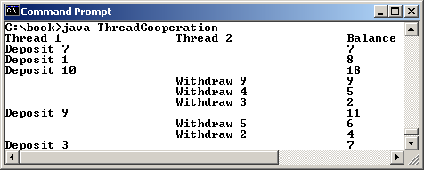
Example: Thread Cooperation
Write a program that demonstrates thread cooperation. Suppose that you create and launch two threads, one deposits to an account, and the other withdraws from the same account. The second thread has to wait if the amount to be withdrawn is more than the current balance in the account. Whenever new fund is deposited to the account, the first thread notifies the second thread to resume. If the amount is still not enough for a withdrawal, the second thread has to continue to wait for more fund in the account. Assume the initial balance is 0 and the amount to deposit and to withdraw is randomly generated.
ThreadCooperation
Run

Slide 191
Java’s Built-in Monitors (Optional)
Locks and conditions are new in Java 5. Prior to Java 5, thread communications are programmed using object’s built-in monitors. Locks and conditions are more powerful and flexible than the built-in monitor. For this reason, this section can be completely ignored. However, if you work with legacy Java code, you may encounter the Java’s built-in monitor. A monitor is an object with mutual exclusion and synchronization capabilities. Only one thread can execute a method at a time in the monitor. A thread enters the monitor by acquiring a lock on the monitor and exits by releasing the lock. Any object can be a monitor. An object becomes a monitor once a thread locks it. Locking is implemented using the synchronized keyword on a method or a block. A thread must acquire a lock before executing a synchronized method or block. A thread can wait in a monitor if the condition is not right for it to continue executing in the monitor.

Slide 192
wait(), notify(), and notifyAll()
Use the wait(), notify(), and notifyAll() methods to facilitate communication among threads.
The wait(), notify(), and notifyAll() methods must be called in a synchronized method or a synchronized block on the calling object of these methods. Otherwise, an IllegalMonitorStateException would occur.
The wait() method lets the thread wait until some condition occurs. When it occurs, you can use the notify() or notifyAll() methods to notify the waiting threads to resume normal execution. The notifyAll() method wakes up all waiting threads, while notify() picks up only one thread from a waiting queue.

Slide 193
Example: Using Monitor
The wait(), notify(), and notifyAll() methods must be called in a synchronized method or a synchronized block on the receiving object of these methods. Otherwise, an IllegalMonitorStateException will occur.
When wait() is invoked, it pauses the thread and simultaneously releases the lock on the object. When the thread is restarted after being notified, the lock is automatically reacquired.
The wait(), notify(), and notifyAll() methods on an object are analogous to the await(), signal(), and signalAll() methods on a condition.

Slide 194
Case Study: Producer/Consumer (Optional)
Consider the classic Consumer/Producer example. Suppose you use a buffer to store integers. The buffer size is limited. The buffer provides the method write(int) to add an int value to the buffer and the method read() to read and delete an int value from the buffer. To synchronize the operations, use a lock with two conditions: notEmpty (i.e., buffer is not empty) and notFull (i.e., buffer is not full). When a task adds an int to the buffer, if the buffer is full, the task will wait for the notFull condition. When a task deletes an int from the buffer, if the buffer is empty, the task will wait for the notEmpty condition. The interaction between the two tasks is shown in Figure 29.19.

Slide 195
Case Study: Producer/Consumer (Optional)
Listing 29.10 presents the complete program. The program contains the Buffer class (lines 43-89) and two tasks for repeatedly producing and consuming numbers to and from the buffer (lines 15-41). The write(int) method (line 58) adds an integer to the buffer. The read() method (line 75) deletes and returns an integer from the buffer.
For simplicity, the buffer is implemented using a linked list (lines 48-49). Two conditions notEmpty and notFull on the lock are created in lines 55-56. The conditions are bound to a lock. A lock must be acquired before a condition can be applied. If you use the wait() and notify() methods to rewrite this example, you have to designate two objects as monitors.
ConsumerProducer
Run

Slide 196
Blocking Queues (Optional)
§22.8 introduced queues and priority queues. A blocking queue causes a thread to block when you try to add an element to a full queue or to remove an element from an empty queue.

Slide 197
Concrete Blocking Queues
Three concrete blocking queues ArrayBlockingQueue, LinkedBlockingQueue, and PriorityBlockingQueue are supported in JDK 1.5, as shown in Figure 29.22. All are in the java.util.concurrent package. ArrayBlockingQueue implements a blocking queue using an array. You have to specify a capacity or an optional fairness to construct an ArrayBlockingQueue. LinkedBlockingQueue implements a blocking queue using a linked list. You may create an unbounded or bounded LinkedBlockingQueue. PriorityBlockingQueue is a priority queue. You may create an unbounded or bounded priority queue.

Slide 198
Producer/Consumer Using Blocking Queues
Listing 29.11 gives an example of using an ArrayBlockingQueue to simplify the Consumer/Producer example in Listing 29.11.
ConsumerProducerUsingBlockingQueue
Run

Slide 199
Semaphores (Optional)
Semaphores can be used to restrict the number of threads that access a shared resource. Before accessing the resource, a thread must acquire a permit from the semaphore. After finishing with the resource, the thread must return the permit back to the semaphore, as shown in Figure 29.29.

Slide 200
Creating Semaphores
To create a semaphore, you have to specify the number of permits with an optional fairness policy, as shown in Figure 29.29. A task acquires a permit by invoking the semaphore’s acquire() method and releases the permit by invoking the semaphore’s release() method. Once a permit is acquired, the total number of available permits in a semaphore is reduced by 1. Once a permit is released, the total number of available permits in a semaphore is increased by 1.

Slide 201
Deadlock
Sometimes two or more threads need to acquire the locks on several shared objects. This could cause deadlock, in which each thread has the lock on one of the objects and is waiting for the lock on the other object. Consider the scenario with two threads and two objects, as shown in Figure 29.15. Thread 1 acquired a lock on object1 and Thread 2 acquired a lock on object2. Now Thread 1 is waiting for the lock on object2 and Thread 2 for the lock on object1. The two threads wait for each other to release the in order to get the lock, and neither can continue to run.

Slide 202
Preventing Deadlock
Deadlock can be easily avoided by using a simple technique known as resource ordering. With this technique, you assign an order on all the objects whose locks must be acquired and ensure that each thread acquires the locks in that order. For the example in Figure 29.15, suppose the objects are ordered as object1 and object2. Using the resource ordering technique, Thread 2 must acquire a lock on object1 first, then on object2. Once Thread 1 acquired a lock on object1, Thread 2 has to wait for a lock on object1. So Thread 1 will be able to acquire a lock on object2 and no deadlock would occur.

Slide 203
Thread States
A thread can be in one of five states: New, Ready, Running, Blocked, or Finished.

Slide 204
Synchronized Collections
The classes in the Java Collections Framework are not thread-safe, i.e., the contents may be corrupted if they are accessed and updated concurrently by multiple threads. You can protect the data in a collection by locking the collection or using synchronized collections.
The Collections class provides six static methods for wrapping a collection into a synchronized version, as shown in Figure 29.27. The collections created using these methods are called synchronization wrappers.

Slide 205
Vector, Stack, and Hashtable
Invoking synchronizedCollection(Collection c) returns a new Collection object, in which all the methods that access and update the original collection c are synchronized. These methods are implemented using the synchronized keyword. For example, the add method is implemented like this:
public boolean add(E o) {
synchronized (this) { return c.add(o); }
}
The synchronized collections can be safely accessed and modified by multiple threads concurrently.
The methods in java.util.Vector, java.util.Stack, and Hashtable are already synchronized. These are old classes introduced in JDK 1.0. In JDK 1.5, you should use java.util.ArrayList to replace Vector, java.util.LinkedList to replace Stack, and java.util.Map to replace Hashtable. If synchronization is needed, use a synchronization wrapper.

Slide 206
Fail-Fast
The synchronization wrapper classes are thread-safe, but the iterator is fail-fast. This means that if you are using an iterator to traverse a collection while the underlying collection is being modified by another thread, then the iterator will immediately fail by throwing java.util.ConcurrentModificationException, which is a subclass of RuntimeException. To avoid this error, you need to create a synchronized collection object and acquire a lock on the object when traversing it. For example, suppose you want to traverse a set, you have to write the code like this:
Set hashSet = Collections.synchronizedSet(new HashSet());
synchronized (hashSet) { // Must synchronize it
Iterator iterator = hashSet.iterator();
while (iterator.hasNext()) {
System.out.println(iterator.next());
}
}
Failure to do so may result in nondeterministic behavior, such as ConcurrentModificationException.

Slide 207
SwingWorker
As discussed in §29.6, all Swing GUI events are processed in a single event dispatch thread. If an event requires a long time to process, the thread cannot attend to other tasks in the queue. To solve this problem, you should run the time-consuming task for processing the event in a separate thread. Java 6 introduced SwingWorker. SwingWorker is an abstract class that implements Runnable. You can define a task class that extends SwingWorker, run the time-consuming task in the task, and update the GUI using the results produced from the task. Figure 29.28 defines SwingWorker.

Slide 208
SwingWorker

Slide 209
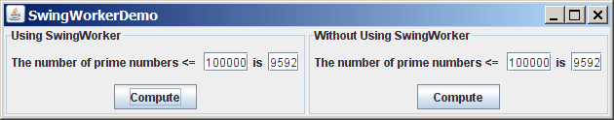
SwingWorker Demo
SwingWorkerDemo
Run

Slide 210
TIP
Two things to remember when writing Swing GUI programs,
Time-consuming tasks should be run in SwingWorker.
Swing components should be accessed from the event dispatch thread only.

Slide 211
JProgressBar
JProgressBar is a component that displays a value graphically within a bounded interval. A progress bar is typically used to show the percentage of completion of a lengthy operation; it comprises a rectangular bar that is "filled in" from left to right horizontally or from bottom to top vertically as the operation is performed. It provides the user with feedback on the progress of the operation. For example, when a file is being read, it alerts the user to the progress of the operation, thereby keeping the user attentive.
JProgressBar is often implemented using a thread to monitor the completion status of other threads. The progress bar can be displayed horizontally or vertically, as determined by its orientation property. The minimum, value, and maximum properties determine the minimum, current, and maximum length on the progress bar, as shown in Figure 9.20.

Slide 212
JProgressBar Methods

Slide 213
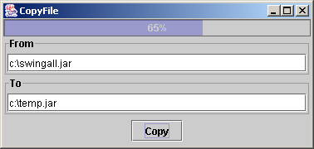
Example: JProgressBar Demo
Objective: Write a GUI application that lets you copy files. A progress bar is used to show the progress of the copying operation.
CopyFile
Run

